Slide 1
High- Efficiency Pumping Systems
STEPHEN PUTNAM/ JESSICA MORRISON
JANUARY, 2016

Slide 2
Presentation Overview
Objective: Seeking TF approval of draft abstract
Measure Description
This measure is for installing fractional horsepower circulator pumps with brushless permanent magnet pump (BLPM) motors or electrically commutated motors (ECM). (EV TRM)
Program Implementation
Abstract Data and Methods
Summary of Proposed Parameters
Additional Information Needed
Summary of Questions for the TF

Slide 3
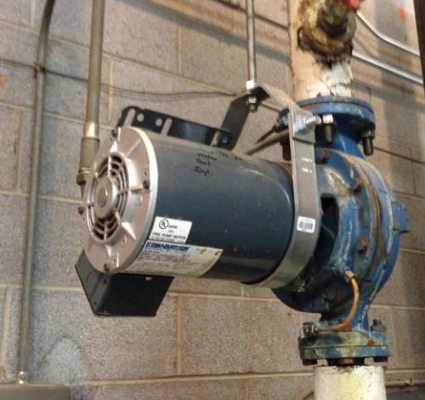
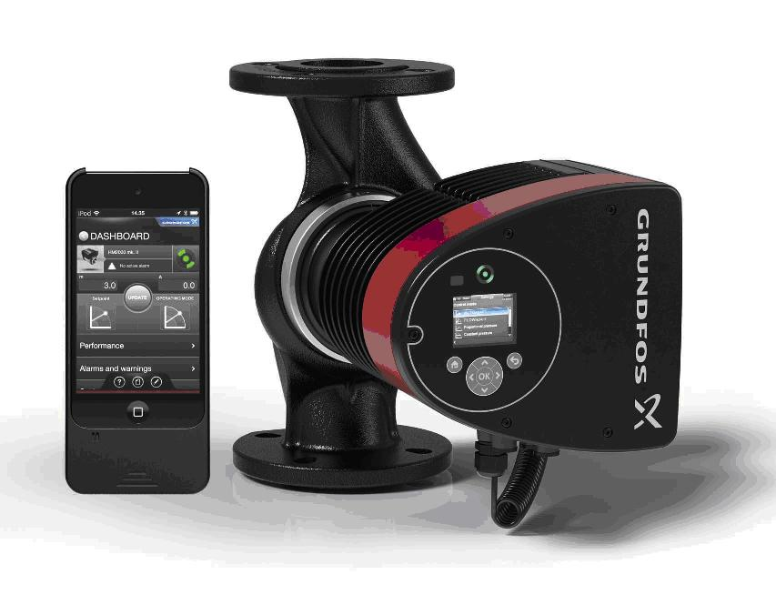
Measure Description
Base Case
Measure Case
Market Standard Pumping System
None or Valve Controller
VFD (if used, none if less than 25 HP)
Standard or Premium Efficient Motor
Wet End Pump
Efficient Pumping Solution
(Demand) Integrated Control Scheme
Integrated VFD (starting at fractional HP)
EE Motor (ECM, MLE Motor)
Highly Efficient Wet End Pump
Notes:
Scope of the discussion today revolves around 10 hp and lower, we will discuss the different applications in a moment.
No efficiency standards in CA or in the US today for pumps, but there is ECM requirements for fans in CA.
The DOE issued a final rule in December for pump standards, however, they will not go into effect until 2020 and our e-product pumps exceed these standards today.
Incentives make a huge impact because the end-user is incentivized to replace the entire pump.
In both the EPRI and the Focus on Energy TRM the baseline condition or measure is defined as:
Description of Baseline Condition
The baseline condition is a standard efficiency, constant volume PSC pump for domestic heating or
cooling circulation without variable speed capabilities.
Description of Efficient Condition
The efficient condition is a properly sized, high-efficiency ECM pump for domestic heating or cooling
circulation with variable speed capabilities to match demand.
Savings for this measure are from the reduction in the pump motor size, the variable speed capability of
the pump, and the increased efficiency of the ECMs versus the fraction horsepower PSC motors.
nd logic with Grundfos Go – 2015 Green Proving Ground Application

Slide 4
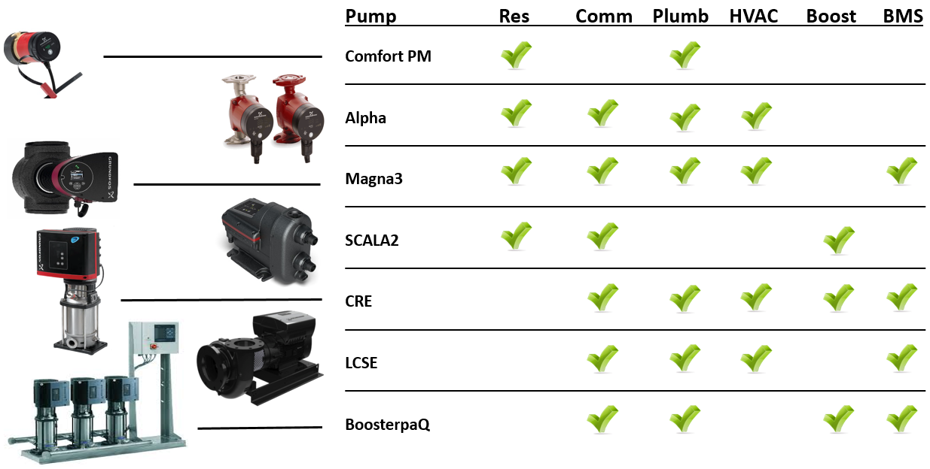
E-Products/ Applications…
Notes:
E-Products cover a vast array of applications and hydraulic ranges. For our purposes we will be focusing on 10 HP and below, however, Grundfos has e-products in larger HP as well.

Slide 5
Technology Details & Energy Savings Opportunities Unitary Solution Evolution…
Notes:
Discuss the unitary solution and how it offers the highest ETA (wire to water efficiency).
Market and utilities typically view pumps as a third party option by incentivizing for VFDs and motors independently.

Slide 6
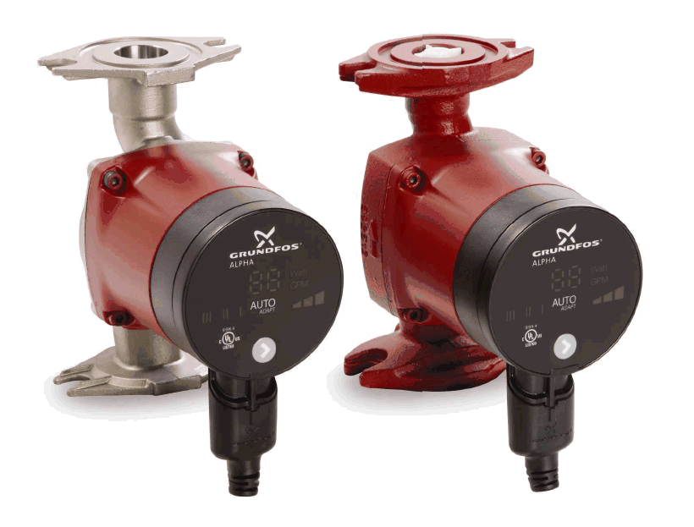
Program Implementation
Units: per pump incentive based on max watts
Measure Application and Delivery Type
Upstream/ Midstream (Targeted Distributor), Deemed (ROB)
Prescriptive
Eligibility
Climate Zones: All
Building Types: All Commercial and Multifamily Buildings, Residential Replacement
Target Market
Incentives are offered to distributors for installation under the following scenarios:
Plumbing Applications (Hot Water Recirculation, Boosting, etc.)
HVAC Applications (Heating and Cooled Water, Geothermal, etc.)
Market Potential
According to EPRI Report (#3002001762) in the U.S. there are ~30 million installations of circulator pumps, annual sales of approximately 3 million units
In CA that is estimated to be 3.6 million installed circulators in service, with annual sales of 365,400 units
Unitary solution via upstream/ midstream adoption has very large market potential:
Smart Pump market share is 5% in areas where there is NO program
Efficiency Vermont and other N.E. upstream/ midstream programs estimated market transformation between 75% - 85%
Notes:
Target Market:
Based on the test results new applications for this technology has been identified. According to EPRI applications include:
• Domestic hot-water re-circulation
• Geo-thermal heat pump application that uses circulation pumps to circulate water/glycol or other refrigerant (please refer to Figure 5-1)
• Industrial circulation systems
• Dairy farm and other farm applications
• Irrigation applications
• Industrial heat pump applications
• Solar water heating applications
Market Potential
- Market size is dictated by population/ building density
Market Size: 30M circulator pumps in US x 12.18% CA population of total US = 3.6 M

Slide 7
Abstract Data and Methods: Baseline/ Measure
Baseline/ measure data collection
EPRI Report (“Assessment of New Energy Efficient Circulator Pump Technology”, Product ID: 1020132, Published: Nov 15, 2010)
Actual Market Data
Existing Upstream/ Midstream Program Data
Additional utility program references
Focus on Energy TRM, Efficiency Vermont TRM, Energize Conneticut, EPRI Report (Assessment of New Motor Technologies and their Applications, study #3002001762)
Baseline/ measure methodology
EPRI simulation of market standard versus unitary solution in lab constructed closed loop system.
Both pumps were tested under identical operating conditions.
Power meter was used to collect data on voltage, current, power factor and power consumed.
Savings was calculated based on difference in results from power meter.
Notes:
Question – consolidate slides?
If yes, explain that data and methods are used for both baseline and measure.
Relevant to CA market
1) The same methodology would be used to deem savings per the baseline.
Not looking at any particular application looking at the pump performance – how does a smart pump operate under the same conditions as a “dumb” pump. It is not geographic specific whatsoever.
Also relevant because CA has the largest market size of pumps in the U.S.

Slide 8
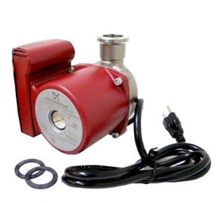
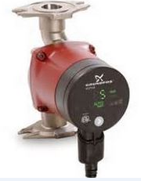
Additional Proposed Parameters
Measure Costs (Incurred Contractor Cost)
Baseline cost (Grundfos UP 15-29 SU/LC, P/N: 59896776): $231
Measure cost (Grundfos Alpha 15-55 SF/LC, P/N: 59896834): $336
Incremental cost: $105
Source: Grundfos local sales team
EUL
EPRI and Efficiency Vermont claim 20 years
DOE describes average lifetime between 11 and 23 years, and uses 15 year as average EUL
Focus on Energy claim 15 year
Source: Efficiency Vermont TRM 2013, Measure Number: I-A-7-a, TRM User Manual No. 2013-82
NTG
0.95
Source: 2014 Efficiency Vermont Gross-to-Net Factors Report
SHECPMTR BLPM Circulator Pump
SHECPMTR BLPM Circulator Pump> 3 HP
Project Track: 6032UPST Residential Upstream
vs.
Baseline
Measure
Notes:
Efficiency Vermont claims 95% Savings, 5% Free Ridership

Slide 9
Summary of Parameters
Parameter | Value (or Range) | Confidence Level (High, Medium, Low)
kWh/year | 885 (EPRI) | High
kW/year | 0.101 (EPRI)* | High
Therms/year | 30.20 (EPRI/Conversion) | High
EUL | 20 Years (EPRI/ EV) | High
IMC | $105 (Market Knowledge) | High
NTG | 0.95 (EV) | High
Estimated TRC: Waiting on Eff VT/ FoE/ CL&P
Notes:
** Caveat is that the EPRI report doesn’t take into account the decrease in number of run time hours. While Efficiency Vermont only assumes 1000 hours of run time with the Alpha (high-efficiency circulator).

Slide 10
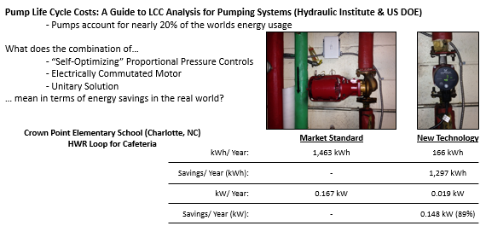
Technology Details & Energy Savings Opportunities Energy Savings (Residential/ Light Commercial)…

Slide 11
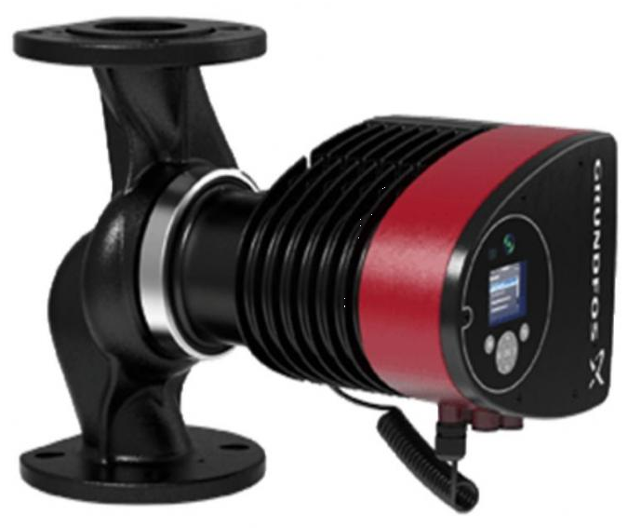
Technology Details & Energy Savings Opportunities Energy Savings – Commercial

Slide 12
Target Market/ Customers The Contractors Dilemma…
Pump Fails
End-user is relieved, but next day realizes he doesn’t know what was installed
Energy bill arrives, and is higher than before
Contractor arrives. Uses oversized pump because he had it available
Contractor responds to call, hoping he has the pump in his truck
Contractor called
Pump is installed and system is back up and running
Immediate action required
Missed Opportunity for Utility Programs
Notes:
- 80% replacement market, 95% of those pumps are fixed-speed, market standard
- Contractors make pump selection based on price, homeowners left to pay energy bill

Slide 13
Delivery/ Deployment Approach Midstream Program Deployment – Success Story…
Howard Merson – Strategic Planning Manager
Efficiency Vermont
hmerson@veic, phone: 802-540-7812
Manufacturer Representative
Wholesale Distribution
Contractor
Building/ Home Owner
Supply Information
Rebate Paid
Utility
Administrator Benefits (VEIC)
Processing fewer rebates
Account Management efforts more focused
Compared to downstream programs:
Labor Savings: 45% reduction in admin labor costs
Rebate budget used more effectively: 26% reduction in rebate cost/kWh
Overall program cost/kWh reduced by 28%
Notes:
Vermont Energy Investment Corporation who evaluates the midstream program.
VEIC: HPCP as a total of sales: 2013: approx. 1%, 2014: 46% (this takes valves, pipes and fittings into sales)

Slide 14
Delivery/ Deployment Approach Midstream Program Deployment – Success Story…
Notes:
Vermont Energy Investment Corporation who evaluates the midstream program.
VEIC: HPCP as a total of sales: 2013: approx. 1%, 2014: 46% (this takes valves, pipes and fittings into sales)

Slide 15
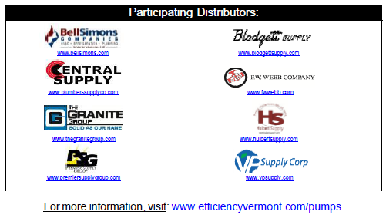
Efficiency Vermont Qualifying Products
Incentive Level | Manufacture | Qty of Models
$50 | Armstrong | 1
 | Bell & Gossett | 2
 | Grundfos | 13
 | TACO | 2
 | Wilo | 3
$200 | Armstrong | 0
 | Bell & Gossett | 3
 | Grundfos | 17
 | TACO | 1
 | Wilo | 4
$600 | Armstrong | 6
 | Bell & Gossett | 0
 | Grundfos | 23
 | TACO | 0
 | Wilo | 3

Slide 16
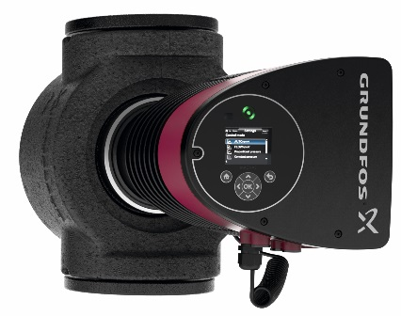
Additional Information Needed
Proven Technology with Existing Programs
Program | ST | Program Type | Plumbing | HVAC | Incentive Range
Efficiency Vermont | VT | Up/Mid Stream | X | X | $50 - $600
Energize Connecticut | CT | Up/Mid Stream | X | X | $100 - $750
Mass Save | MA | Up/Mid Stream | X | X | $100
Consumers Energy | MI | Prescriptive | X | X | $25 - $500
Detroit Edison | MI | Prescriptive | X | X | March 1, 2016
Focus On Energy | WI | Prescriptive | X | X | $100 - $400

Slide 17
Additional Information Needed
DEER 2004-2005 Impacted Measure Sections
Measure Name | Abbreviation | ID
VSD Chilled Water Loop Pump | CHWVP | D03-047
VSD Hot Water Loop Pump | HWVPm | D03-049
Variable Flow Hydronic Heat Pump Loop | HHPVF | D03-070
Efficient Motors – Chilled Water Loop Pumps | ECMLP | D03-089
Efficient Motors – Hot Water Loop Pumps | EMHLP | D03-089
Efficient Motors – Conditioned Water Loop Pumps | EMTLP | D03-089
Circulation Pump Timeclock Retrofit | WHTC1 | D03-095

Slide 18
Summary of Questions for the TF
We found tangential measures in DEER 2004-2005, are there any current measures that would apply?
Non-DEER work papers?
Is it code?

Slide 19
Marketing Strategy Strategic Partnership w/ Utilities and Implementers…

Slide 20
Efficiency Vermont Upstream Results through October 2015
Contact
Howard Merson – Strategic Planning Manager
Efficiency Vermont
hmerson@veic
phone: 802-540-7812

Slide 21
Efficiency Vermont Upstream Results through October 2015
Contact
Howard Merson – Strategic Planning Manager
Efficiency Vermont
hmerson@veic
phone: 802-540-7812

Slide 22
Efficiency Vermont Upstream Results through October 2015
Contact
Howard Merson – Strategic Planning Manager
Efficiency Vermont
hmerson@veic
phone: 802-540-7812

Slide 23
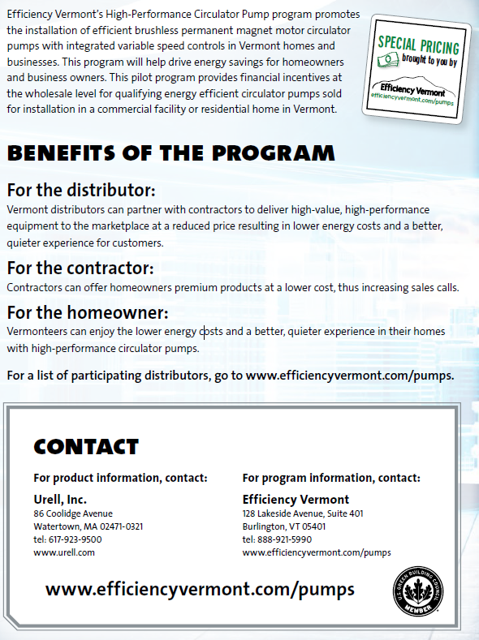
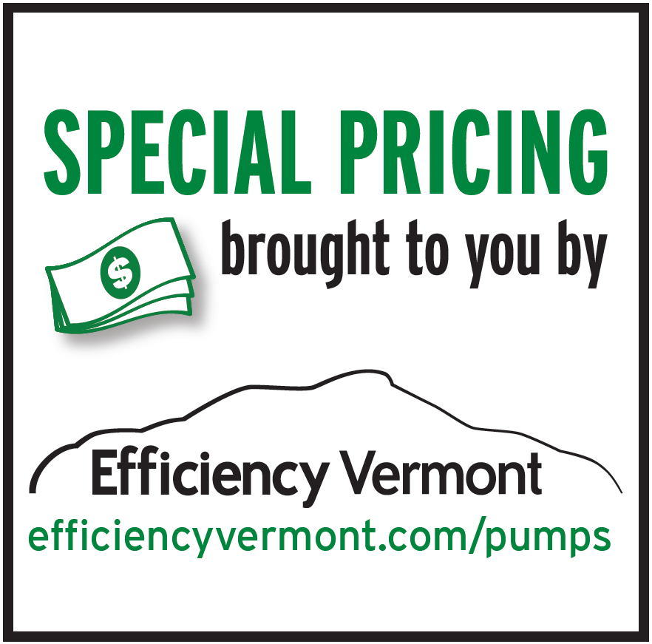
Marketing Strategy Point of Sales – Marketing Material (Efficiency Vermont)…
Notes:
Marketing Collateral for Eff VT Program…
Box Stickers
End Caps
Counter Mats

Slide 24
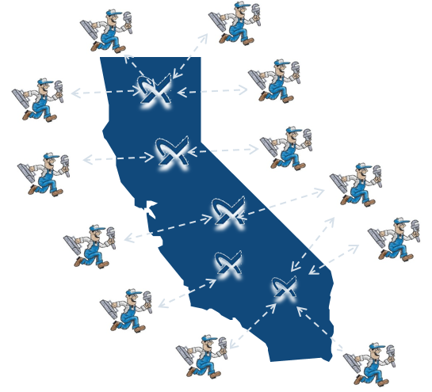
Psychology of the Market Place
Manufacturers work directly with distribution, contractors and end-users to serve efficient products to California
Reps sell direct to wholesale
Priority to sell high margin product
Contractor buys product
Decision is driven by cost and ease of installation
End-user reaps benefit of efficient product
INCENTIVES TRANSFORM MARKET
Notes:
Because you can see whose priorities are what, you can see the impact a midstream program would have.

Slide 25
Target Market/ Customers The Pumping Market Story…
95 % of pumps today are fixed speed, no VFD, no ECM,
Absolutely NO LOGIC!
This means 50 – 90% more energy
Missed Opportunity for Utility Programs

Slide 26
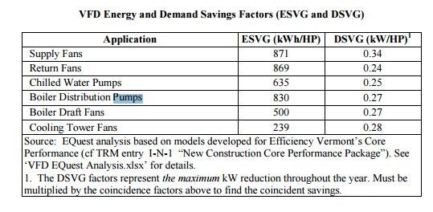
Efficiency Vermont Deemed Savings for Residential Upstream Savings

