Slide 1
Food Services
Cal TF Tier 2 Presentation
Ayad Al-SHaikh
October 2017

Slide 2
Food Services Consolidation
Overview
Define Measures
At the start, in general:
  Measures consistently defined
  Methodologies consistently applied
Input consensus achieved
  Permutation / Implementation fields
  Savings inputs
Missing information
  Update cost data
  Address 30% reduction disposition
Stage 2
  Update Base / Measure case inputs with Qualified Product List information
  Individual Measures:
    Restructure Rack Oven (Energy Star)
    Update Ice Machine (Code)
    Review new Upright Dishwasher (New)
Understand Energy Savings
Sync Methodology
Input Consensus
Missing Information
Stage 1 vs Stage 2
Stage 2
Define Offerings
Understand Cost

Slide 3
Define Measures
Original Measure List

Slide 4
Define Measures
Final Measure List
Blue text = Changed item

Slide 5
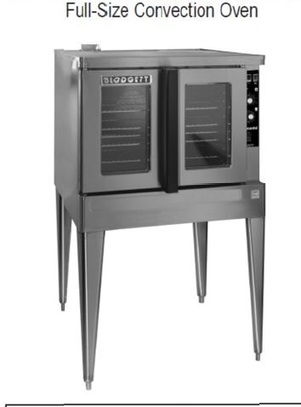
Measure Consensus
2.01 – Commercial Convection Oven
Offerings
  Half and Full
  Electric and Gas
  Removed Full Large Oven Offering
Stage 1 Issues
  Updated cost data – increased cost
  Minor Net Savings and TRC adjustment
Stage 2 Issues
  Addressing 30% reduction disposition waiting for final CEC Study that is expected in Q1 2018
  Update base and measure case inputs with 2017 QPL
Black text = Discussed in Sept Cal TF Meeting
Blue text = Not discussed in Sept Cal TF Meeting
Italics text = Item that has not been completed

Slide 6
Summary Table Details
Percent Change Within Measure
  Change of savings/cost from 2016 values to eTRM values
  Uses claims quantities from 2016 values
  End of year values are used in comparison
    Note that sometimes values change throughout the year
    Best indication of what the value would have been in the following year
Absolute Change & Comparison
  Total – Translates percentages to total value
Notes:
NOTE – Total and % of Measure are only different due to MCE impacts.

Slide 7
Measure Consensus
2.01 – Commercial Convection Oven
Offerings
  Half and Full
  Electric and Gas
  Removed Full Large Oven Offering
Stage 1 Issues
  Updated cost data – increased cost
  Minor Net Savings and TRC adjustment
Stage 2 Issues
  Addressing 30% reduction disposition waiting for final CEC Study that is expected in Q1 2018
  Update base and measure case inputs with 2017 QPL
Black text = Discussed in Sept Cal TF Meeting
Blue text = Not discussed in Sept Cal TF Meeting
Italics text = Item that has not been completed

Slide 8
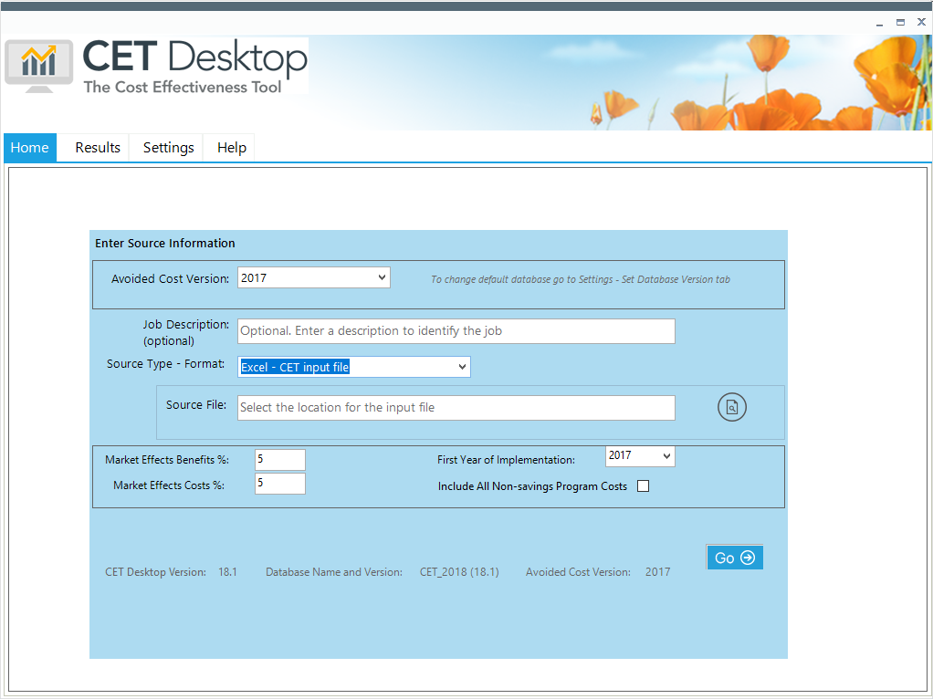
Summary Table Details
Cost Effectiveness values
  Uses CET Desktop, v18.1
  Assumptions:
    2017 avoided costs, 5% Market Effects Benefit/Cost (default)
    Program and Admin costs set to zero – see differences
    Rebate values taken from PG&E catalog (only one value)
    Calculated for various offerings, but “weighted” based upon 2016 claims quantities
    Typically, only one baseline per offering (not PA specific)
Notes:
NOTE – Total and % of Measure are only different due to MCE impacts.

Slide 9
Measure Consensus
2.01 – Commercial Convection Oven
Offerings
  Half and Full
  Electric and Gas
  Removed Full Large Oven Offering
Stage 1 Issues
  Updated cost data – increased cost
  Minor Net Savings and TRC adjustment
Stage 2 Issues
  Addressing 30% reduction disposition waiting for final CEC Study that is expected in Q1 2018
  Update base and measure case inputs with 2017 QPL
Black text = Discussed in Sept Cal TF Meeting
Blue text = Not discussed in Sept Cal TF Meeting
Italics text = Item that has not been completed

Slide 10
Input Consensus
2.01 – Commercial Convection Oven
Measure Permutations
Measure Implementation

Slide 11
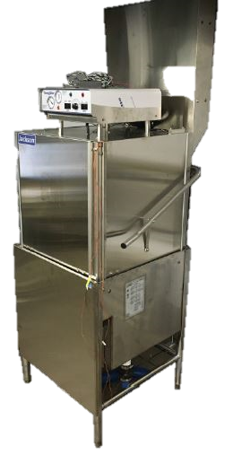
Measure Consensus
2.02 – Commercial Dishwasher
Offering
  Tier 2 only
  Permutations included for High Temp and Low Temp
  Current methodology does not differentiate based upon Climate Zone; retaining that methodology (but applied across all Climate Zones)
  Removed Tier 1 savings threshold. Published data on shipments already shows high adoption
Stage 1 Issues
  Increased POU EUL
  Decreased POU Offerings; new Measure expected for Upright, Door-Type Dishwasher
  Decreased POU savings from an older methodology due to number of racks/day estimate, which is based upon best available data
  Savings average over all Climate Zones rather than just PG&E Climate Zones
Stage 2 Issues
  Improve data on water savings; reported to be conservative
  Improve data on number of racks per day
Black text = Discussed in Sept Cal TF Meeting
Blue text = Not discussed in Sept Cal TF Meeting
Italics text = Item that has not been completed
Notes:
Gallons/rack per day is the most significant driver of savings; uncertainty is higher in this variable then any other by far.

Slide 12
Input Consensus
2.02 – Commercial Dishwasher
Measure Permutations
Measure Implementation
Notes:
Not including text descriptions because these get long.
Consider adding: High Impact measure?; “Effects life cycle savings?”, Changed Cost?, Changed TRC?

Slide 13
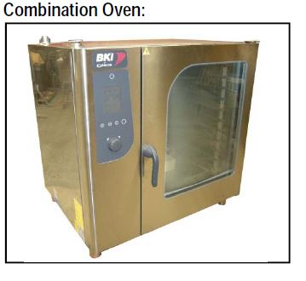
Measure Consensus
2.03 – Commercial Combination Oven
Offerings
  Permutations vary with Offerings (<15, 15 – 28, >28 Pan Models)
  Electric and Gas
Stage 1 Issues
  Updated cost data – increase for <15, 15-28 Pans; decreased for >28 Pans
    Methodology revised to use direct quotes (not AutoQuotes) because of large variation in cost from brand to brand
    Caused by different marketing strategy for this largely imported
  TRC changes link to cost adjustment
  SCE number of days updated from 355 to 365 days/yr. This keeps values consistent throughout the whole sector so that hours can be changed uniformly after being normalized to 365 days/yr.
Stage 2 Issues
  Update base and measure case inputs with 2017 QPL
Black text = Discussed in Sept Cal TF Meeting
Blue text = Not discussed in Sept Cal TF Meeting
Italics text = Item that has not been completed
Notes:
365 days/year is reasonable because it is a weighted average value that is based upon best available data; it takes into account all building types that have kitchens and survey data (2014 CEC study) to show operating days. The result shows that hours/day that is represented as equiv of 365 d/yr is conservative.
For the combi ovens, there is a greater variation between AutoQuotes pricing and street (online dealer) pricing from brand to brand than is typically seen for other categories of equipment. This is due to the different marketing strategy for this largely imported technology in comparison to the predominantly domestic manufacturing associated with other types of equipment. For this reason, the average discount applied to the published list prices in AutoQuotes is not a good indicator of combi oven incremental measure pricing.

Slide 14
Input Consensus
2.03 – Commercial Combination Oven
Measure Permutations
Measure Implementation
Notes:
Not including text descriptions because these get long.
Consider adding: High Impact measure?; “Effects life cycle savings?”, Changed Cost?, Changed TRC?

Slide 15
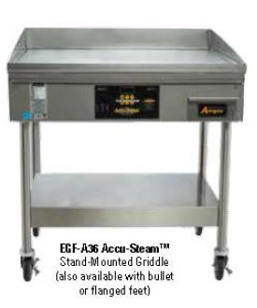
Measure Consensus
2.04 – Commercial Griddles
Offerings
  Savings estimated “per foot”
  Electric and Gas
Stage 1 Issues
  Updated cost data – increased cost
  SCE number of days updated from 355 to 365 days/yr. This keeps values consistent throughout the whole sector so that inputs can be changed uniformly.
  SCE Normalized Idle Energy Rate (W/ft²) updated from 355 to 293 W/ft² that represents values from the latest QPL
Stage 2 Issues
  Update base and measure case inputs with 2017 QPL
  Should double griddles and single griddles be treated differently
Black text = Discussed in Sept Cal TF Meeting
Blue text = Not discussed in Sept Cal TF Meeting
Italics text = Item that has not been completed
Notes:
NOTE: irregularity of cost decrease and TRC decrease is caused by error in SCG reported “claim” cost for a 3-foot griddle (3x).
365 days/year is reasonable because it is a weighted average value that is based upon best available data; it takes into account all building types that have kitchens and survey data (2014 CEC study) to show operating days. The result shows that hours/day that is represented as equiv of 365 d/yr is conservative.

Slide 16
Input Consensus
2.04 – Commercial Griddles
Measure Permutations
Measure Implementation
Notes:
Not including text descriptions because these get long.
Consider adding: High Impact measure?; “Effects life cycle savings?”, Changed Cost?, Changed TRC?

Slide 17
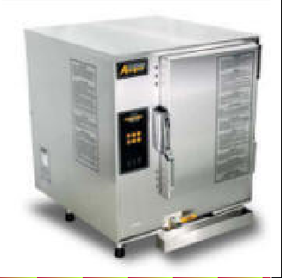
Measure Consensus
2.05 – Commercial Steamers
Offerings
  Electric and Gas
Stage 1 Issues
  Updated cost data – increased electric; decreased gas
  POU savings increase based upon updated methodology (Unknown Standby Loss factor)
Stage 2 Issues
  Update base and measure case inputs with 2017 QPL
  Addressing 30% reduction disposition
Black text = Discussed in Sept Cal TF Meeting
Blue text = Not discussed in Sept Cal TF Meeting
Italics text = Item that has not been completed

Slide 18
Input Consensus
2.05 – Commercial Steamers
Measure Permutations
Measure Implementation
Notes:
Not including text descriptions because these get long.
Consider adding: High Impact measure?; “Effects life cycle savings?”, Changed Cost?, Changed TRC?

Slide 19
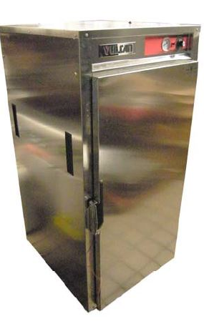
Measure Consensus
2.07 – Insulated Hot Food Holding Cabinets
Offerings
  Permutations vary by Capacity (Half and Full)
  ¾ sized unit offering was removed since no QPL units exist
Stage 1 Issues
  Updated cost data – no updated cost data available
    Harmonized costs – SDG&E cost decreased; previously used a 40% reduction factor
  SDG&E and SCE Cabinet Volume (ft³) and Normalized Idle Energy Rate measure case inputs updated for consistency to the average QPL values of 2014:
    Half size – 10 ft³, 5 W/ft³
    Full size – 25 ft³, 11.3 W/ft³
Stage 2 Issues
  Update base and measure case inputs with 2017 QPL
Black text = Discussed in Sept Cal TF Meeting
Blue text = Not discussed in Sept Cal TF Meeting
Italics text = Item that has not been completed

Slide 20

Input Consensus
2.07 – Insulated Hot Food Holding Cabinets
Measure Permutations
Measure Implementation
Notes:
Not including text descriptions because these get long.
Consider adding: High Impact measure?; “Effects life cycle savings?”, Changed Cost?, Changed TRC?

Slide 21
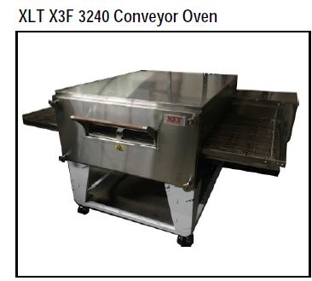
Measure Consensus
2.08 – Commercial Conveyor Oven-Gas
Offerings
  Permutations vary by Capacity (Large >=25”)
  Capacity size of Small <25” was removed since no QPL units existed
Stage 1 Issues
  Updated cost data – increased cost; small data set
    1 base and 3 measure case costs
    Recommend not updating this cost
  Include reduction from Disposition for PG&E and SCG
Stage 2 Issues
  Update base and measure case inputs with 2017 QPL
  Addressing 30% reduction disposition
  Consider basing savings on oven size based upon belt width and oven length
Black text = Discussed in Sept Cal TF Meeting
Blue text = Not discussed in Sept Cal TF Meeting
Italics text = Item that has not been completed

Slide 22
Input Consensus
2.08 – Commercial Conveyor Oven-Gas
Measure Permutations
Measure Implementation
Notes:
Not including text descriptions because these get long.
Consider adding: High Impact measure?; “Effects life cycle savings?”, Changed Cost?, Changed TRC?

Slide 23
Measure Consensus
2.09 – Commercial Electric Deck Oven
Offering
  Single offering
Stage 1 Issues
  New measure; low measure usage
  Measure Extension
  Added measure for POUs
  Added measure for PG&E and SDG&E
Stage 2 Issues
  None
Black text = Discussed in Sept Cal TF Meeting
Blue text = Not discussed in Sept Cal TF Meeting
Italics text = Item that has not been completed

Slide 24
Input Consensus
2.09 – Commercial Electric Deck Oven
Measure Permutations
Measure Implementation
Notes:
Not including text descriptions because these get long.
Consider adding: High Impact measure?; “Effects life cycle savings?”, Changed Cost?, Changed TRC?

Slide 25
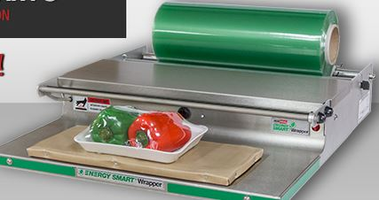
Measure Consensus
2.10 – Commercial Hand Wrap Machines
Offering
  Single offering
Stage 1 Issues
  New measure; low measure usage
  Measure Extension
  Added measure for POUs
  Added measure for PG&E and SDG&E
Stage 2 Issues
  None
Black text = Discussed in Sept Cal TF Meeting
Blue text = Not discussed in Sept Cal TF Meeting
Italics text = Item that has not been completed

Slide 26
Input Consensus
2.10 – Commercial Hand Wrap Machines
Measure Permutations
Measure Implementation
Notes:
Not including text descriptions because these get long.
Consider adding: High Impact measure?; “Effects life cycle savings?”, Changed Cost?, Changed TRC?

Slide 27
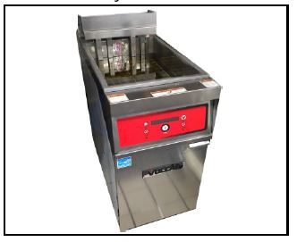
Measure Consensus
2.11 – Commercial Fryers, Gas & Electric
Offerings
  Permutations vary by Gas and Electric
Stage 1 Issues
  Updated cost data – increased electric; decreased gas
  PG&E Production Capacity updated to 71 lbs/hr (electric) – increase savings
  SDG&E Product Capacity updated to base case 60 lbs/hr and measure case 67 lbs/hr (gas) – decrease savings; already harmonized at end of year
Stage 2 Issues
  Update base and measure case inputs with 2017 QPL
  Addressing 30% reduction disposition
Black text = Discussed in Sept Cal TF Meeting
Blue text = Not discussed in Sept Cal TF Meeting
Italics text = Item that has not been completed
Notes:
2014 update with PG&E and SCE showed that this was the most current data (71 lbs/yr – electric)

Slide 28
Input Consensus
2.11 – Commercial Fryers, Gas & Electric
Measure Permutations
Measure Implementation
Notes:
Not including text descriptions because these get long.
Consider adding: High Impact measure?; “Effects life cycle savings?”, Changed Cost?, Changed TRC?

Slide 29
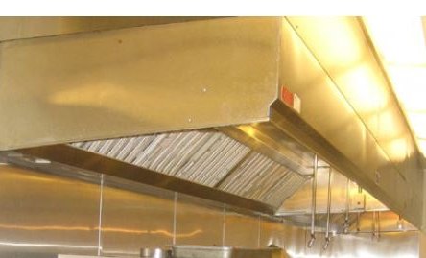
Measure Consensus
2.12 – Exhaust Hood Demand Controlled Ventilation
Offering
  Permutations vary by Climate Zone, for gas only (16 CZs)
    Electric savings do not vary with Climate Zone
Stage 1 Issues
  CDF applied to demand values – decreased PG&E savings
  PG&E electric savings methodology the matches, but older values used
Stage 2 Issues
  Significant variation in savings can be due to hours of use dependent upon building type. Improve as data becomes available.
(gas savings varying with Climate Zone)
(gas savings not varying with Climate Zone)
Black text = Discussed in Sept Cal TF Meeting
Blue text = Not discussed in Sept Cal TF Meeting
Italics text = Item that has not been completed
Notes:
NOTE – SCE cost difference is cause by what looks like an error in the Claims data. Costs are very high

Slide 30
Input Consensus
2.12 – Exhaust Hood Demand Controlled Ventilation
Measure Permutations
Measure Implementation
Notes:
Not including text descriptions because these get long.
Consider adding: High Impact measure?; “Effects life cycle savings?”, Changed Cost?, Changed TRC?

Slide 31
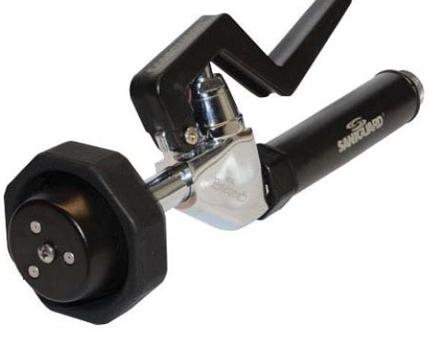
Measure Consensus
2.13 – Low-Flow Pre-Rinse Spray Valves
Offering
  Permutations vary by Measure Case (0.65 gpm, 1.15 gpm)
  Permutations vary by Climate Zone (16 CZ)
    Due to ground water temperature
  Removes offers with Measure Case of 1.07 gpm and 1.28 gpm
Stage 1 Issues
  Addressing – Hours/day updated to PG&E methodology (waiting for study)– increases savings
  Base case reduced to 1.4 gpm to PG&E methodology to reflect lower baseline due to expected market conditions – decreases savings
  Expanded Climate Zone permutations to all zones since variation is about 11% across CA
  Measure Extension
  Added POU TRM measure
Stage 2 Issues
  Consider a targeted DI for ultra low flow measure cases
Black text = Discussed in Sept Cal TF Meeting
Blue text = Not discussed in Sept Cal TF Meeting
Italics text = Item that has not been completed

Slide 32
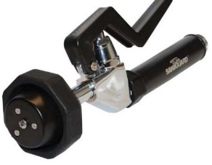
Input Consensus
2.13 – Low-Flow Pre-Rinse Spray Valves
Measure Permutations
Measure Implementation
Notes:
Not including text descriptions because these get long.
Consider adding: High Impact measure?; “Effects life cycle savings?”, Changed Cost?, Changed TRC?

Slide 33
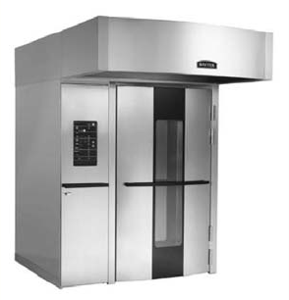
Measure Consensus
2.14 – Commercial Rack Oven-Gas
Offering
  Permutations vary by Size (Single, Double)
Stage 1 Issues
  None.
Stage 2 Issues
  Align specifications with Energy Star that would change the efficiency thresholds and add an Idle Rate specification. Multiple, less efficient units that would drop off the QPL – increases savings
  Update base and measure case inputs with 2017 QPL
Black text = Discussed in Sept Cal TF Meeting
Blue text = Not discussed in Sept Cal TF Meeting
Italics text = Item that has not been completed

Slide 34
Input Consensus
2.14 – Commercial Rack Oven-Gas
Measure Permutations
Measure Implementation
Notes:
Not including text descriptions because these get long.
Consider adding: High Impact measure?; “Effects life cycle savings?”, Changed Cost?, Changed TRC?

Slide 35
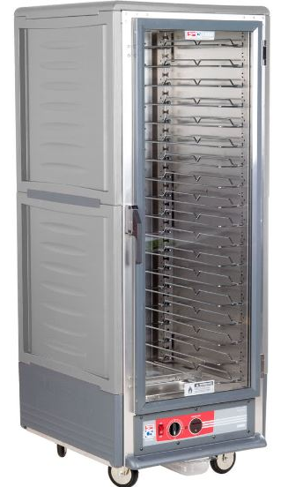
Measure Consensus
2.17 – High Density Holding Cabinet
Offering
  Per unit
  Combined 20- and 24-hour units to be consistent with ET Results
Stage 1 Issues
  Consolidated savings approaches for SCE and SDG&E
Measure Extension
  Added POU TRM measure
  Added measure for PG&E
Stage 2 Issues
  None
Black text = Discussed in Sept Cal TF Meeting
Blue text = Not discussed in Sept Cal TF Meeting
Italics text = Item that has not been completed

Slide 36
Input Consensus
2.17 – High Density Holding Cabinet
Measure Permutations
Measure Implementation

Slide 37
Moving Forward to Stage 2
Disposition Updates
Base Case / Measure Case Updates

Slide 38
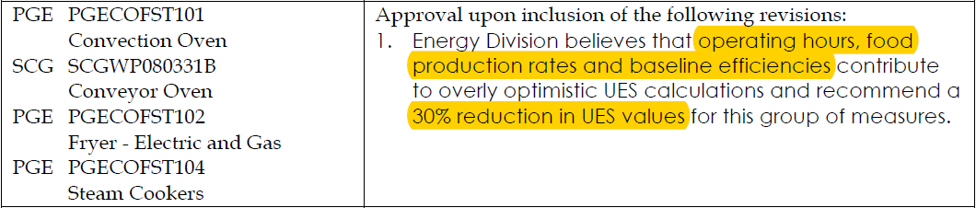
Stage 2 Changes
Disposition that Reduces Savings by 30%
Re-visit addressing this Disposition as part of Stage 2
  Documenting normalized “Operating Hours”
    From: 12 hrs/day normalized to 365 days/year
    To: 13.4 hrs/day normalized to 365 days/year
  Updating Baseline Efficiency and Production Rates
    Not directly substantiated, but added to study scope
Recommend an interim value for POUs
Stage 2: Published data required to support the eTRM values
  CEC Published study expected in Q1 2018

Slide 39
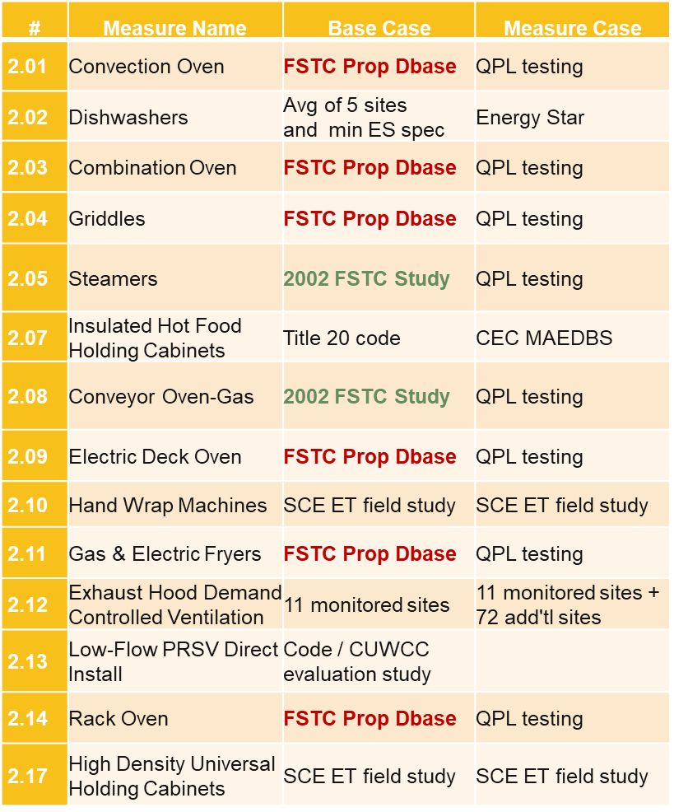
Food Service Sources
# | Measure Name | Base Case | Measure Case
2.01 | Convection Oven | FSTC Prop Dbase | QPL testing
2.02 | Dishwashers | Avg of 5 sites and min ES spec | Energy Star
2.03 | Combination Oven | FSTC Prop Dbase | QPL testing
2.04 | Griddles | FSTC Prop Dbase | QPL testing
2.05 | Steamers | 2002 FSTC Study | QPL testing
2.07 | Insulated Hot Food Holding Cabinets | Title 20 code | CEC MAEDBS
2.08 | Conveyor Oven-Gas | 2002 FSTC Study | QPL testing
2.09 | Electric Deck Oven | FSTC Prop Dbase | QPL testing
2.10 | Hand Wrap Machines | SCE ET field study | SCE ET field study
2.11 | Gas & Electric Fryers | FSTC Prop Dbase | QPL testing
2.12 | Exhaust Hood Demand Controlled Ventilation | 11 monitored sites | 11 monitored sites + 72 add'tl sites
2.13 | Low-Flow PRSV Direct Install | Code / CUWCC evaluation study
2.14 | Rack Oven | FSTC Prop Dbase | QPL testing
2.17 | High Density Universal Holding Cabinets | SCE ET field study | SCE ET field study
Context:
  Efficiency testing is not required, so typically baseline equipment is not tested.
  Some manufactures allowed testing in exchange for the information to be used generally.
Issues:
  Don’t have access to the underlying values for the FSTC Proprietary Database or the 2002 FSTC Technology Assessment Report so we can’t verify or reproduce the input values.
  Don’t know the timeframe for the tests or equipment so we don’t know if they represent current baseline conditions.

Slide 40
Stage 2 – Potential Changes
Without a Baseline Change
Note:
  Newer QPL’s include more efficient units
  5 Measures not using Qualified Product List (QPL) for calculation inputs
    Dishwashers, Deck Oven, Hand Wrap Machines, Exhaust Hood DCV, Pre-Rinse Spray Valves
Notes:
Generally – Qualified products are getting stronger (more efficient)

